Slide 1
Dr. Md Asaduzzaman Khan
Email: asadkhanbmj@yahoo.com
[Brac University, 2023]
Introduction to Biology (BIO 101), Section 2

Slide 2

Chemical Foundations for Cells
Course: BIO 101: Introduction to Biology
Chapter: 2

Slide 3
Elements
An element is a substance that cannot be broken down into any other substance. Every element is made up of its own type of atom. This is why the chemical elements are all very different from each other.
Fundamental forms of matter.

Slide 4
Elements (Cont.)
The periodic table lists all the known elements, grouping together those with similar properties.
Most elements are metals, which are shiny and conduct electricity well. Metals include gold, aluminium and iron which are all solid at room temperature. Mercury is the only metal that is liquid at room temperature.

Slide 5
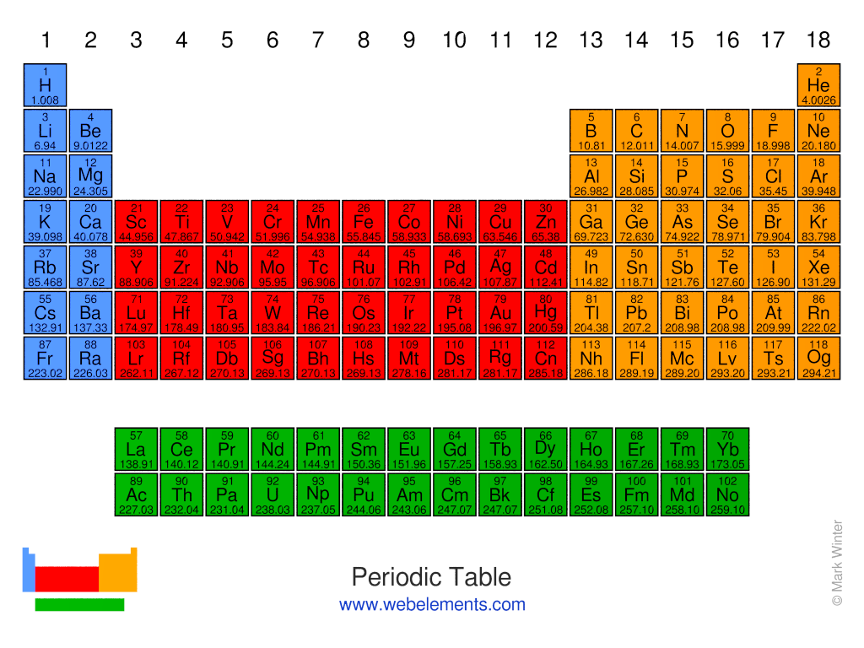

Slide 6
Elements (Cont.)
Some elements are non-metals. Most non-metals are gases at room temperature and do not conduct electricity. Non-metal elements with these properties include oxygen, hydrogen and chlorine. A few non-metals, such as carbon and sulphur, are in a solid state at room temperature.

Slide 7




Most Common Elements in Living Organisms
Oxygen
Hydrogen
Carbon
Nitrogen

Slide 8
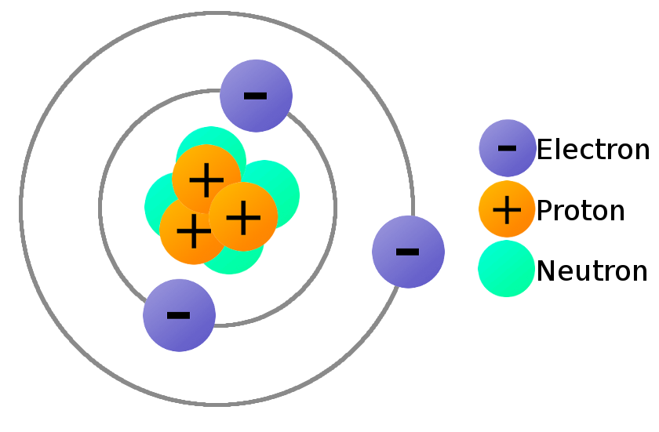
What Are Atoms?
Smallest particles that retain properties of an element
Made up of subatomic particles:
  Protons (+)
  Electrons (-)
  Neutrons (no charge)

Slide 9

Hydrogen and Helium Atoms
electron
proton
neutron
HYDROGEN
HELIUM

Slide 10

Atomic Number
Number of protons
All atoms of an element have the same atomic number
Atomic number of hydrogen = 1
Atomic number of carbon = 6
Atomic number of sodium= 11

Slide 11
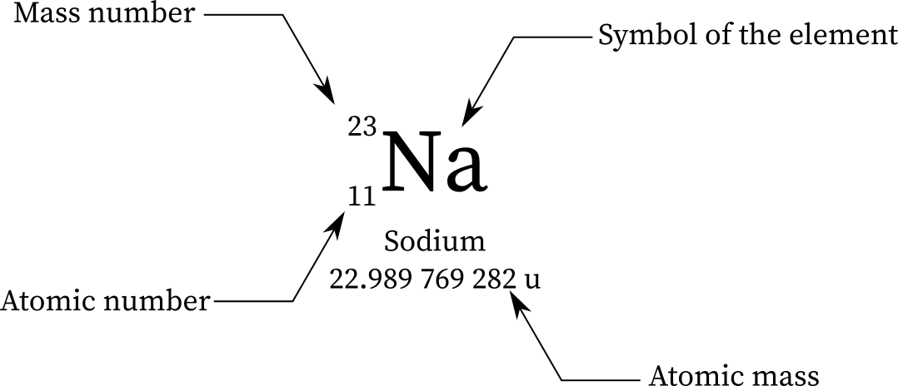
Mass Number
Number of protons
+
Number of neutrons
Isotopes vary in mass number
Isotopes vary in mass number

Slide 12
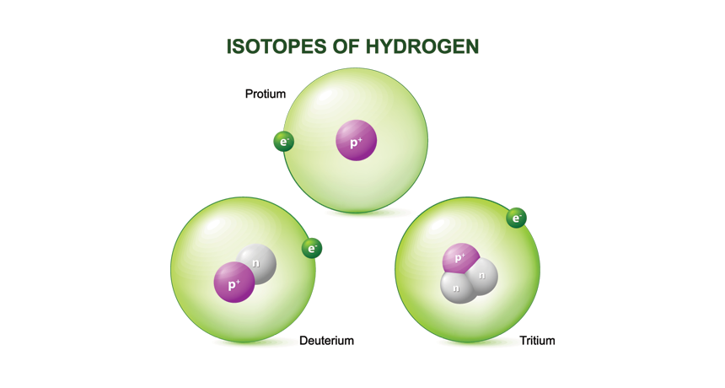
Isotopes
Atoms of an element with different numbers of neutrons (different mass numbers)
Hydrogen 1 or Protium has 1 proton, 0 neutron
Hydrogen 2 or Deuterium has 1 proton, 1 neutron
Hydrogen 3 or Tritium has 1 proton, 2 neutrons

Slide 13
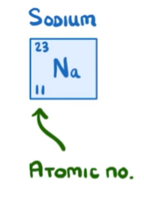
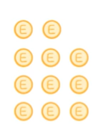
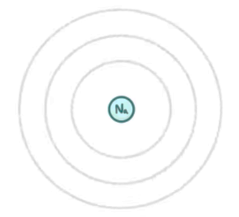
Electrons

Slide 14
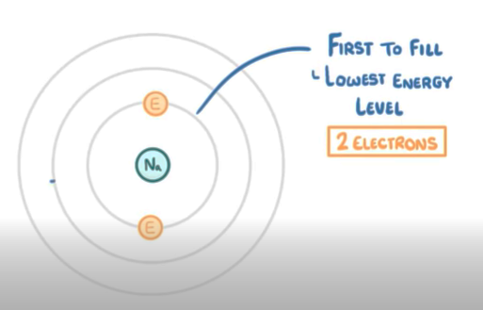
Electrons

Slide 15
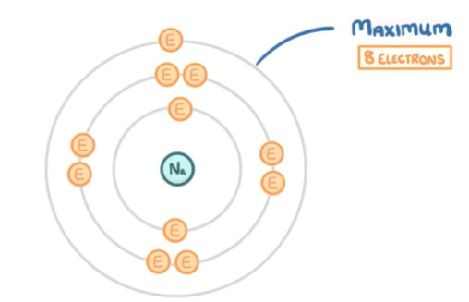
Electrons

Slide 16
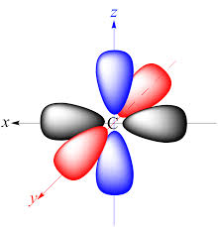
Electrons
Carry a negative charge (-)
Repel one another
Are attracted to protons in the nucleus
Move in orbitals

Slide 17
Electron Orbitals
Orbitals are volumes of space that surround the nucleus
Orbitals can hold up to two electrons
Atoms differ in the number of occupied orbitals
Orbitals closest to nucleus are lower energy and are filled first

Slide 18
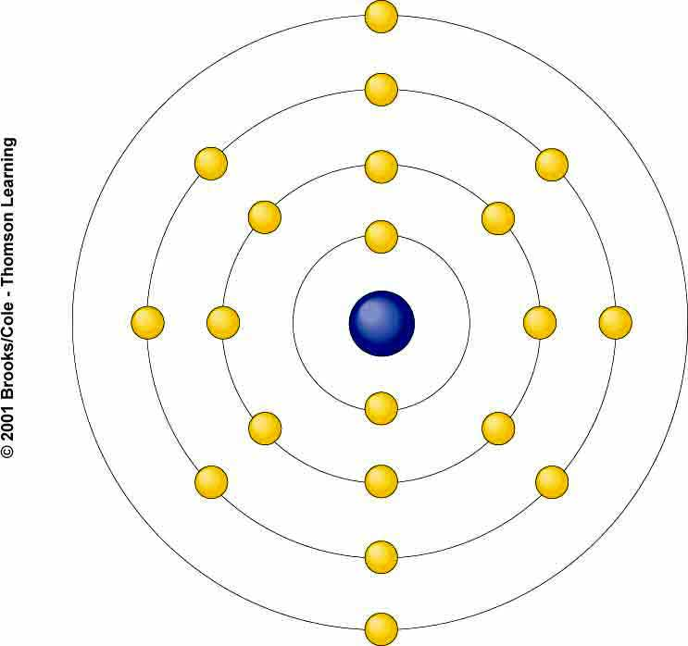
Shell Model
Shell is something that is made up of orbitals
First shell
  Lowest energy
  Holds 1 orbital with up to 2 electrons
Second shell
  4 orbitals hold up to 8 electrons
CALCIUM
20p+ , 20e⁻

Slide 19
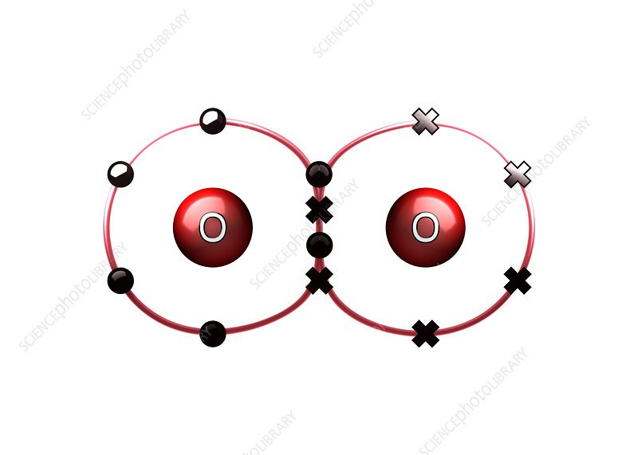
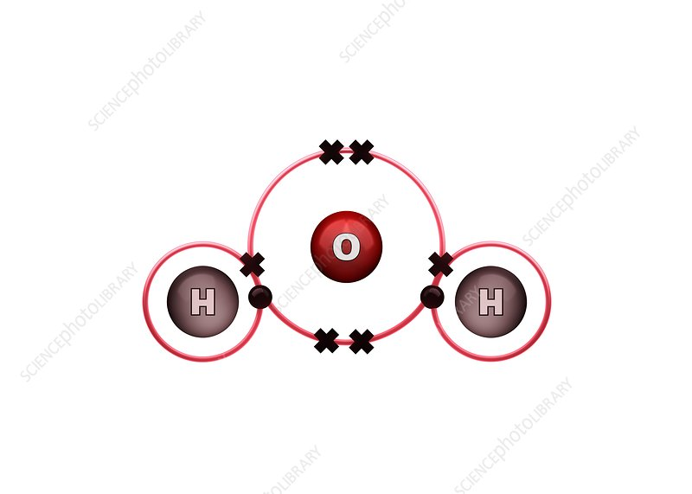
Chemical Bonds
Bond is union between electron structures of atoms
Atoms bond to form molecules
Molecules may contain atoms of only one element - O₂
Molecules of compounds contain more than one element - H₂O

Slide 20
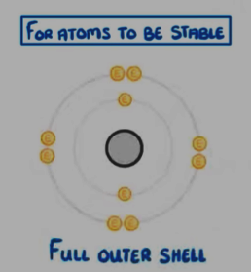
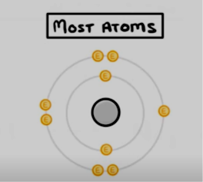

Chemical Bonds

Slide 21
Important Bonds in Biological Molecules
Ionic Bonds
Covalent Bonds
Hydrogen Bonds

Slide 22
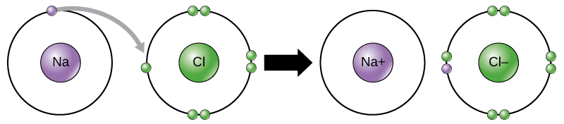
Ionic Bonding
In ionic bond one atom loses electrons, becomes positively charged ion and another atom gains these electrons, becomes negatively charged ion
Charge difference attracts the two ions to each other

Slide 23
Ion Formation
Atom has equal number of electrons and protons - no net charge
Atom loses electron(s), becomes positively charged ion
Atom gains electron(s), becomes negatively charged ion

Slide 24
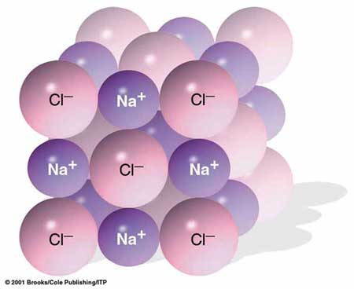
Formation of NaCl
Sodium atom (Na)
  Outer shell has one electron
Chlorine atom (Cl)
  Outer shell has seven electrons
Na transfers electron to Cl forming Na⁺
and Cl⁻
Ions remain together as NaCl

Slide 25
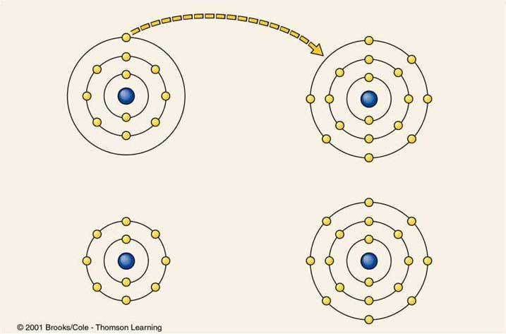
Formation of NaCl
7mm
electron transfer
SODIUM
ATOM
11 p⁺
11 e⁻
CHLORINE
ATOM
17 p⁺
17 e⁻
Na⁺
Cl⁻
SODIUM
ION
11 p⁺
10 e⁻
CHLORINE
ION
17 p⁺
18 e⁻

Slide 26
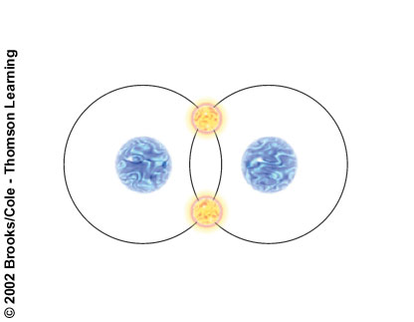
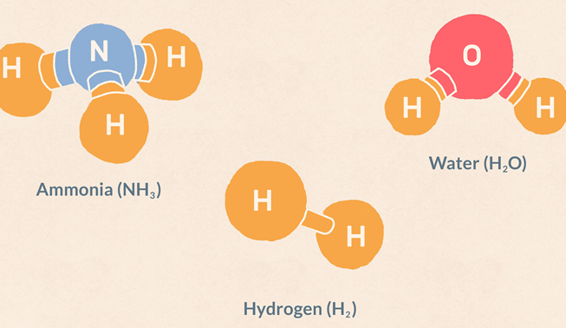
Covalent Bonding
Atoms share a pair or pairs of electrons to fill outermost shell
  Single covalent bond, H₂
  Double covalent bond, H₂O
  Triple covalent bond, NH₃

Slide 27
Covalent Bonding
Depending on the polarity that is creation of positive and negative poles, covalent bonds can be of two types.
Non-polar covalent bond
Polar covalent bond

Slide 28
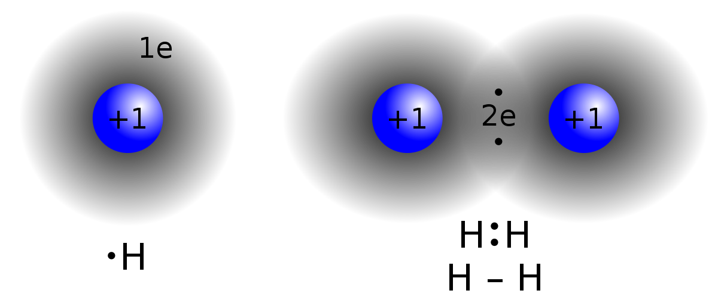
Nonpolar Covalent Bonds
Atoms share electrons equally
Nuclei of atoms have same number of protons
Example: Hydrogen gas (H-H)

Slide 29
Polar Covalent Bonds
Number of protons in nuclei of participating atoms is NOT equal
Electrons spend more time near nucleus with most protons
Water - Electrons more attracted to O nucleus than to H nuclei

Slide 30
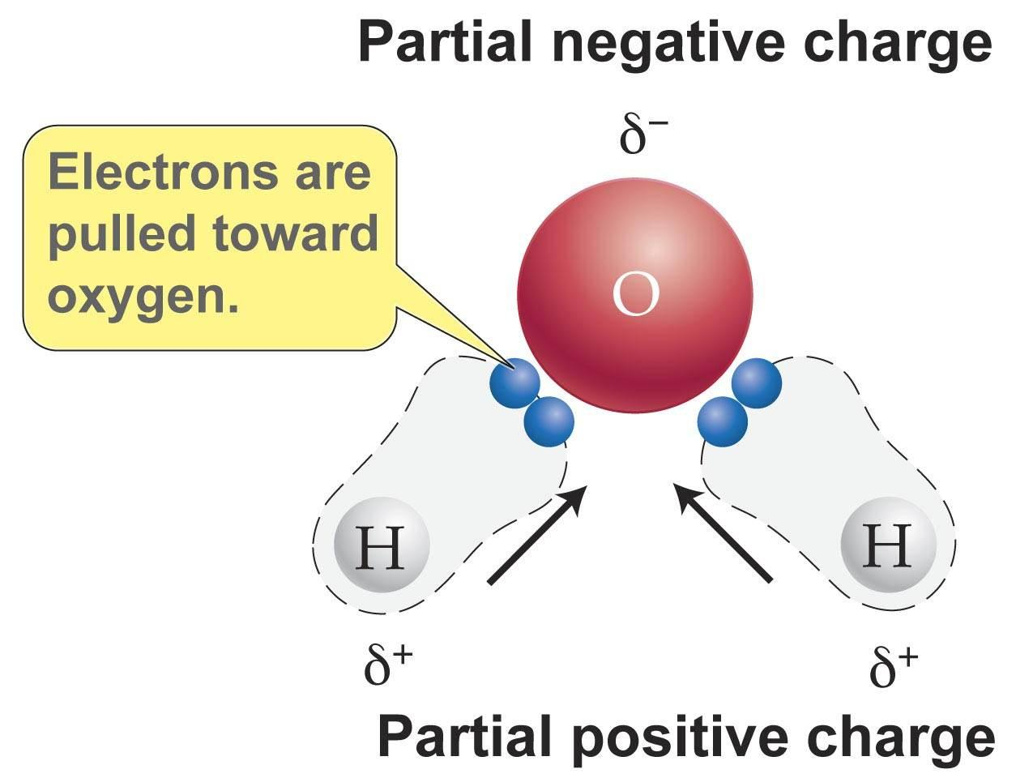
Polar Covalent Bonds

Slide 31
Hydrogen Bonding
Hydrogen bonds are bonds created between hydrogen and highly electronegative molecules.
Molecules held together by polar covalent bonds has no NET charge
However, atoms of the molecule carry different charges
Atom in one polar covalent molecule can be attracted to oppositely charged atom in another such molecule

Slide 32
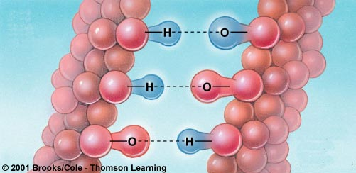
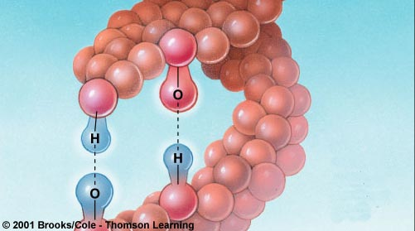
Examples of Hydrogen Bonds
one
large
molecule
another
large
molecule
a large
molecule
twisted
back
on
itself

Slide 33
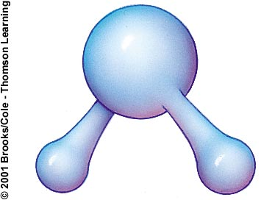
Water Is a Polar Covalent Molecule
Molecule has no net charge
Oxygen end has a slight negative charge
Hydrogen end has a slight positive charge
O
H
H

Slide 34
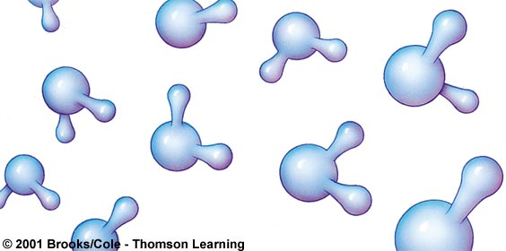
Liquid Water
H
+
+
_
H
+
O
H
+
_
O
+
H
+

Slide 35
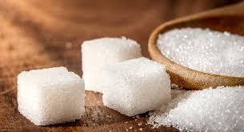
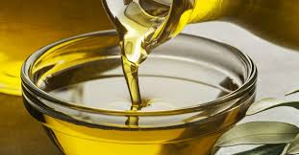
Hydrophilic & Hydrophobic Substances
Hydrophilic substances
  Polar
  Hydrogen bond with water
  Example: sugar
Hydrophobic substances
  Nonpolar
  Repelled by water
  Example: oil

Slide 36
Why Ice Floats
In ice, hydrogen bonds lock molecules in a lattice
Water molecules in lattice are spaced farther apart than those in liquid water
Ice is less dense than water

Slide 37
pH
A figure expressing the acidity or alkalinity of a solution on a logarithmic scale on which 7 is neutral, lower values are more acidic and higher values more alkaline. The values span from 0 to 14. The pH is equal to −log₁₀c, where c is the hydrogen ion concentration in moles per litre.

Slide 38
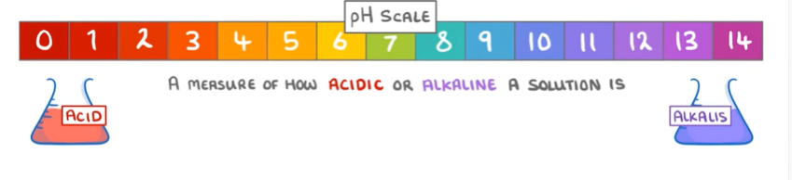
The pH Scale
Measures H⁺ concentration of fluid
Change of 1 on scale means 10X change in H⁺ concentration
Highest H⁺ Lowest H⁺
0---------------------7-------------------14
Acidic Neutral Basic

Slide 39
Examples of pH
Pure water is neutral with pH of 7.0
Acidic
  Stomach acid: pH 1.0 - 3.0
  Lemon juice: pH 2.3
Basic
  Seawater: pH 7.8 - 8.3
  Baking soda: pH 9.0

Slide 40
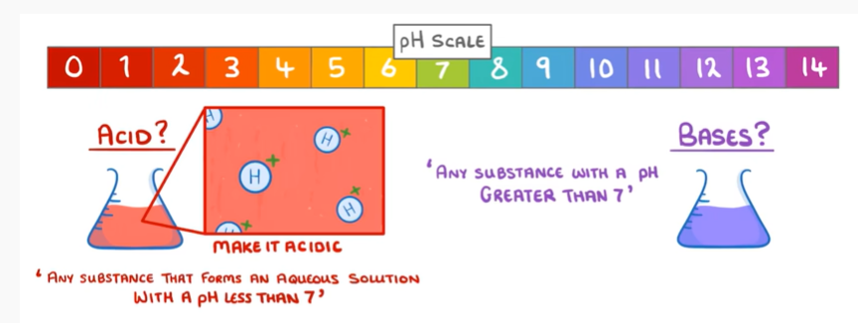
Acids & Bases

Slide 41
Acids & Bases
Acids
  Donate H⁺ when dissolved in water
  Acidic solutions have pH < 7
  Example: HCl
Bases
  Accept H⁺ when dissolved in water
  Basic solutions have pH > 7
  Example: NH₃

Slide 42
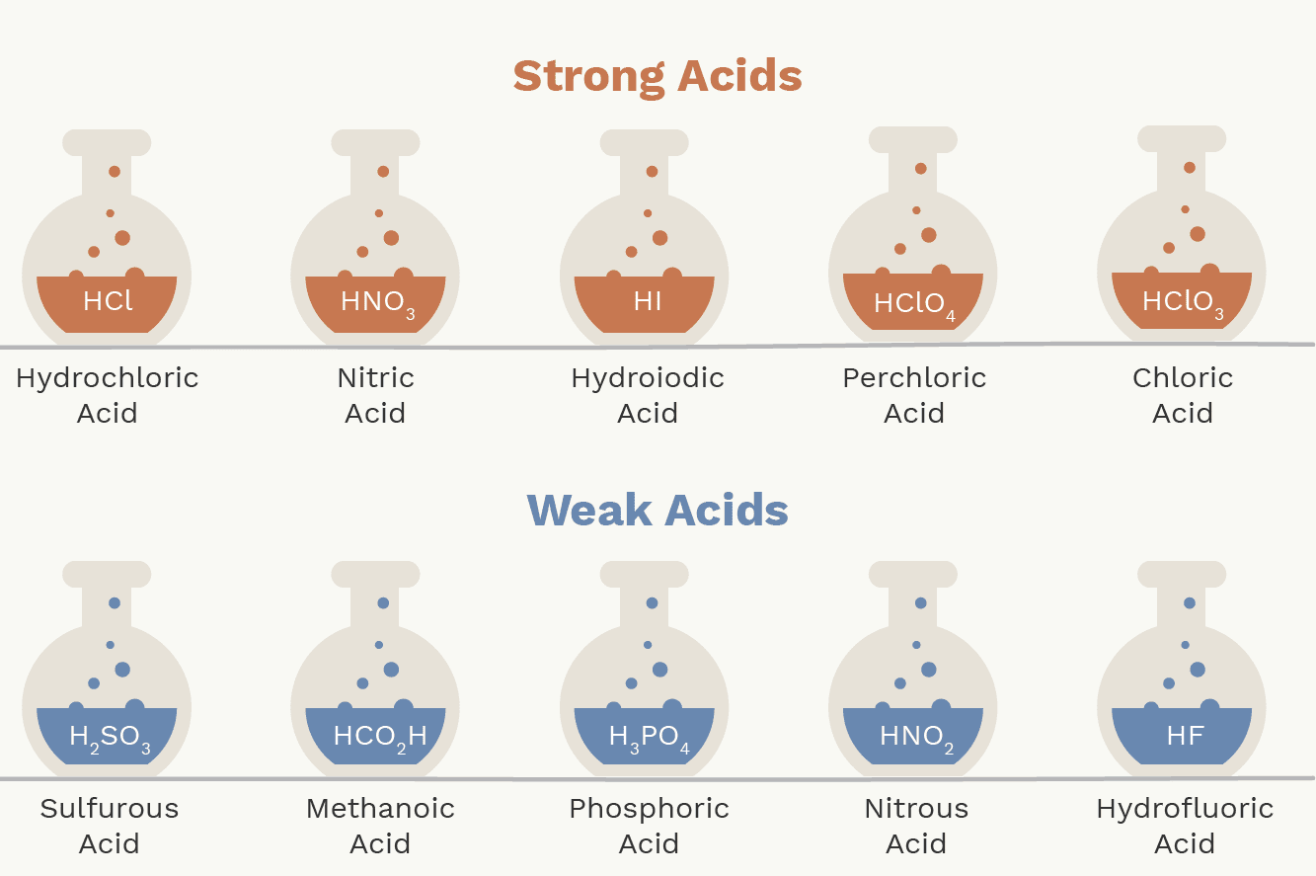
Weak and Strong Acids
Weak acids
  Reluctant H⁺ donors
  Can also accept H after giving it up
  Carbonic acid (H₂CO₃) is example
Strong acids
  Completely give up H⁺ when dissolved
  Hydrochloric acid (HCl) is example

Slide 43
Buffer System or Buffer Solution
A buffer solution is an aqueous solution of a weak acid and its conjugate base, or a weak base and its conjugate acid. Its pH changes very little when a small amount of strong acid or base is added to it.
Buffer solutions are used as a means of keeping pH at a nearly constant value in a wide variety of chemical applications.

Slide 44
Buffer Systems (Cont.)
Many life forms thrive only in a relatively small pH range, so they utilize a buffer solution to maintain a constant pH.
One example of a buffer solution found in nature is blood. The body’s acid–base balance is normally tightly regulated, keeping the arterial blood pH between 7.38 and 7.42.

Slide 45
Types of Buffer Solutions
Buffers are broadly divided into two types: acidic and alkaline buffer solutions.
Acidic buffers are solutions that have a pH below 7 and contain a weak acid and one of its salts. For example, a mixture of acetic acid and sodium acetate acts as a buffer solution with a pH of about 4.75.
Alkaline buffers, on the other hand, have a pH above 7 and contain a weak base and one of its salts. For example, a mixture of ammonium chloride and ammonium hydroxide acts as a buffer solution with a pH of about 9.25.

Slide 46
  Thank you

